Slide 1
IMAGING MASS SPECTROMETRY IN DETECTING TUMOR
HETEROGENEITY

Slide 2
01
INTRODUCTION
02
TECHNIQUES
How the spatial information is obtained
03
INSTRUMENTATION
Ionization, Mass Analysis
04
RESOLUTION
05
CONCLUSION REMARKS

Slide 3
INTRODUCTION
INTRATUMOR HETEROGENEITY

Slide 4
STEPS
Mapped T-SNE
Clustering
Phenotype Association
SAM Analysis
KNN classification
Classify pixels in MSI data

Slide 5
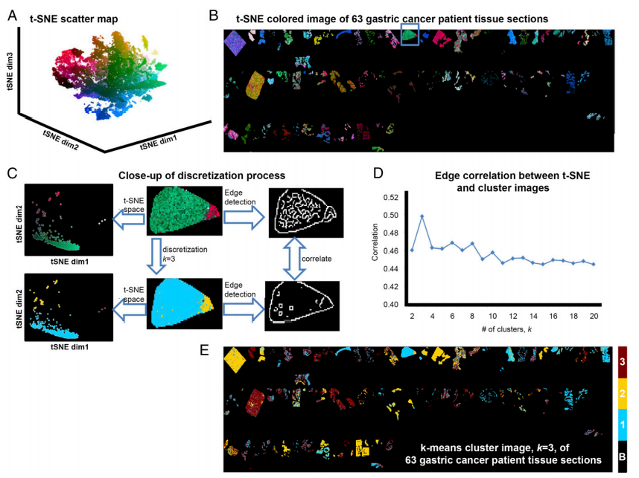
Visualization of Steps

Slide 6
Mass Spectrometry-based Proteomics
This universal technique analyzes complex protein samples.
It’s applied following isolation of the proteins from cell lysates by :
Biochemical Fractionation
Affinity Selection
METHODS
2-D gel
Liquid Chromatography
Capillary Electrophoresis
Molecular scanner gels
Capillary-Isoelectric Focusing

Slide 7
TECHNIQUES
How the spatial information is obtained
The most common and the simplest technique.
It can be described as position-correlated mass spectrometry.
It’s described in MALDI literature as Imaging Spectrometry Imaging (IMS).
MICROPROBE
Microscope mode imaging uses ion-optical microscope elements to project the spatial origin of the ions onto a position-sensitive detector.
It has a finite depth of vision, which makes sample preparation more critical.
MICROSCOPE

Slide 8
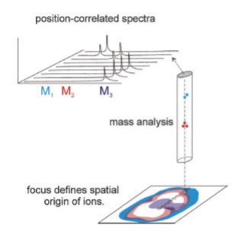
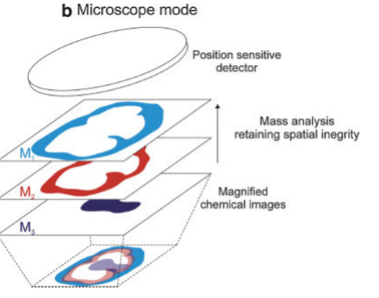
TECHNIQUES
How the spatial information is obtained
MICROPROBE
MICROSCOPE
A focused ionization beam is used to
analyze a small,
localized region of
the sample.
Spatial information is
obtained from within
the ionization spot.
Fig. a
Fig. b
Microprobe mode imaging records mass spectra from an array of designated
positions to construct a
molecular image.
Magnified images of mass resolved ion distributions
are recorded with a 2D
detector.

Slide 9
INSTRUMENTATION
IONIZATION MECHANISMS

Slide 10
INSTRUMENTATION
Ionization Mechanisms
MALDI
Matrix-Assisted Laser Desorption/Ionization
MALDI can record the spatial distribution of high mass molecules using the
chemically specific molecular ions.
It’s spatial resolutions are approximately 25 mm or more .
SIMS is able to provide high spatial resolution images.
It’s molecular ion mass range is much lower than that of MALDI.
SIMS
Secondary Ion Mass Spectrometry

Slide 11
RESOLUTION
There are three types of resolution in an imaging mass spectrometry
It defines the degree of chemical specificity.
It improves the precision of a mass measurement.
It helps improve mass accuracy.
MASS RESOLUTION
LATERAL RESOLUTION
(SPATIAL RESOLUTION)
DEPTH RESOUTION

Slide 12
ARTIFACTS
TOPOGRAPHY
In SIMS, the dependence of the ion yield of a given analyte on its chemical environment is commonly referred to as ‘‘matrix effects.’’
In MALDI, the word matrix is used differently. The matrix is the small organic molecule, typically a small organic acid, added to the sample and is fundamental to the success of the technique.
MATRIX EFFECTS
Prolonged exposure to the electron beam causes thermal damage during SIMS analysis of insulators.
ELECTRON DAMAGE

Slide 13
CONCLUSION
Tumor-specific signatures obtained by protein matrix-assisted laser desorption MSI analysis of primary tumors of gastric cancer (n = 63) and breast cancer (n = 32) were nonlinearly mapped to a 3D space using t-SNE. Using the perceptually linear L*a*b color map to color each pixel according to its position in the t-SNE space, a t-SNE colored image can be obtained that depicts regions characterized by similar mass spectral profiles with similar colors.
To segment the image into a discrete number of clusters, bisecting k-means and edge correlation algorithms were applied. The resulting clusters, or tumor subpopulations, were then statistically compared with the patients’ clinical data (survival for gastric cancer and lymph node metastasis for breast cancer) to identify the subpopulations statistically associated with patient phenotype. LOPO pixel-based and patient-based classifiers were built to cross-validate the identification of tumor subpopulations and patient outcomes.

Slide 14
REFERENCES
Aebersold R, Mann M. 2003. Mass spectrometry-based proteomics. Nature Insights 422:198–207.
Aksyonov SA, Williams P. 2001. Impact desolvation of electrosprayed microdroplets—A new ionization method for mass spectrometry of large biomolecules. Rapid Commun Mass Spectrom 15:2001–2006.
Belu AM, Davies MC, Newton JM, Patel N. 2000. TOF-SIMS characterization and imaging of controlled-release drug delivery systems. Anal Chem 72:5625–5638.
Benguerba M, Brunelle A, Della-Negra S, Depauw J, Joret H, Le Beyec Y, Blain MG, Schweikert EA, Assayag GB, Sudraud P. 1991. Impact of slow gold clusters on various solids: Nonlinear effects in secondary ion emission. Nucl Instr Meth Phys Res B 62:8–22.
Cutler RG, Kelly J, Storie K, Pedersen WA, Tammara A, Hatanpaa K, Troncoso JC, Mattson MP. 2004. Involvement of oxidative stress-induced abnormalities in ceramide and cholesterol metabolism in brain aging and Alzheimer’s disease. PNAS 101: 2070–2075.
Dambach S, Fartmann M, Kriegeskotte C, Bru¨ning C, Hellweg S, Wiesmann HP, Lipinsky D, Arlinghaus HF. 2004. ToF-SIMS and laser-SNMS analysis of apatite formation in extracellular protein matrix of osteoblasts in vitro. Surf Interface Anal 36:711–715.
Fuoco ER, Gillen G, Wijesundara MBJ, Wallace WE, Hanley L. 2001. Surface analysis studies of yield enhancements in secondary ion mass spectrometry by polyatomic projectiles. J Phys Chem B 105:3950–3956.
Gabel D, Preusse D, Haritz D, Grochulla F, Haselsberger K, Frankhauser H, Ceberg C, Peters H-D, Klotz U. 1997. Pharmacokinetics of Na2B12H11SH (BSH) in patients with malignant brain tumors as prerequisite for a Phase I clinical trial of boron neutron capture therapy. Acta Neurochir 139:606–612.

Slide 15
TEAM MEMBERS
Ibrahim
ElSayed
Donia
AbdelSalam
Renad
Taher
Mariam
Ahmed
Mostafa
Yehia

Slide 16
Thank you!

